Slide 1
OpenPose vs PoseNet

Slide 2
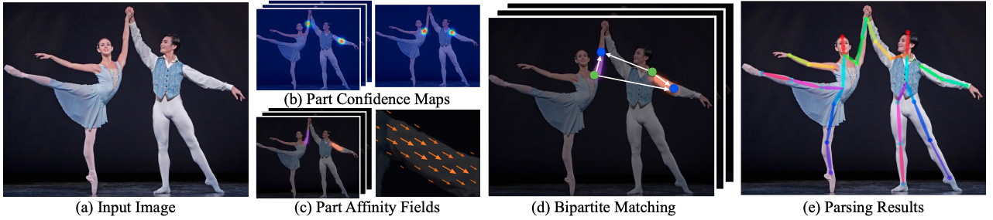
OpenPose
Key features
Real-time 3D single-person keypoint detections
3D triangulation with multiple camera views
Flir camera compatibility
Real-time 2D multi-person keypoint detections 15, 18, 27-keypoint body/foot keypoint estimation
21 hand keypoint estimation
70 face keypoint estimation

Slide 3
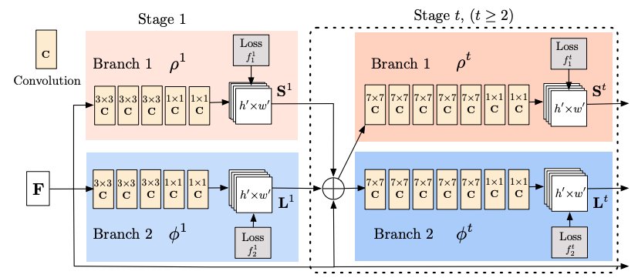
Architecture: Two-branches and Multi-stages
Two-branches: The top branch, shown in beige, predicts the confidence maps (Fig 1b) of different body parts location such as the right eye, left eye, right elbow and others. The bottom branch, shown in blue, predicts the affinity fields (Fig 1c), which represents a degree of association between different body parts.
Multi-Stage: At the first stage (left half of Fig 2), the network produces an initial set of detection confidence maps S and a set of part affinity fields L. Then, in each subsequent stages (right half of Fig 2), the predictions from both branches in the previous stage, along with the original image features F, are concatenated (represented by the + sign in Fig 2) and used to produce more refined predictions. In the OpenPose implementation, the final stage t is chosen to be 6.

Slide 4
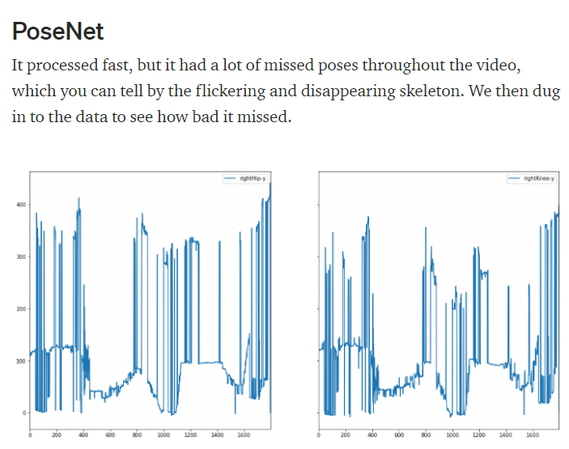

Slide 5
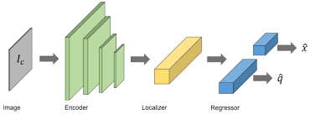
PoseNet Architecture

Slide 6
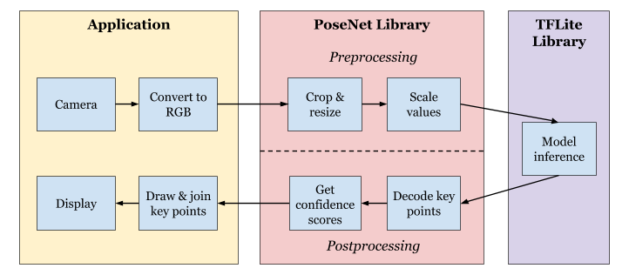
PoseNet Sample Application
The diagram below shows the workflow between the application, PoseNet library, and TensorFlow Lite library.
Developed in Kotlin

Slide 7
PoseNet Model
TensorFlow Lite
Mobile applications for both Android and iOS smartphones
AI Models for Pose Segmentation
A Light-Weight Mobile Model can manipulate a GPU

Slide 8
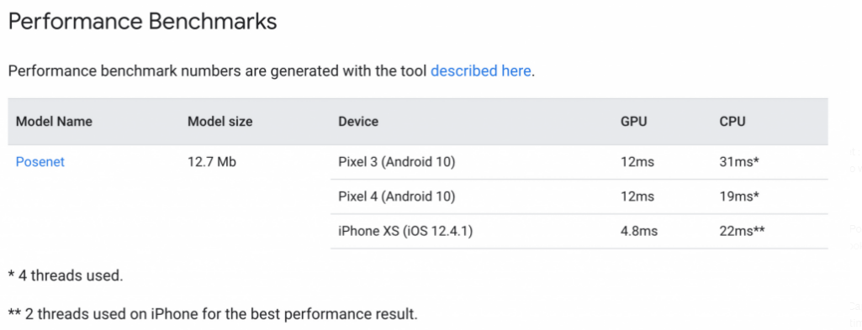

Slide 9
The application performs the following steps for each incoming camera image:
Capture the image data from camera preview and convert it to ARGB_888 format.
Create a Bitmap object to hold the pixels from the RGB format frame data. Crop and scale the Bitmap to the model input size so that it can be passed to the model.
Call the estimateSinglePose() function from the PoseNet library to get the Person object.
Scale the Bitmap back to the screen size. Draw the new Bitmap on a Canvas object.
Use the position of key points obtained from the Person object to draw a skeleton on the canvas. Display the key points with a confidence score above a certain threshold, which by default is 0.5.
44:40

